Slide 1

Chapter 9
Food Service Operations Management

Slide 2
Chapter 9
Exploring the uniqueness in food service operations management and identifying the practice of good service design to create sustainable competitive advantage
This chapter covers:
Service operations management and the role it plays in business success
Service design and the importance of service strategy in managing food and beverage operations
How service strategy is linked to the firm’s competitive advantage and embedded in a sustained way

Slide 3
What is operations management?
Operations management (OM) involves designing and controlling the production of goods and services, to ensure that businesses are efficient in using resources to meet customer requirements
It covers the management of:
  An entire production system
  Converting inputs (raw materials, labour, consumers, and energy), into outputs (goods and services) for consumers
  Resources which produce and deliver products and services
  Processes are both efficient and effective

Slide 4
The origins of operations management
Historically the domain of the manufacturing industries
Last 30 years service management is now recognised as a distinct core discipline
Service operations are characterised by a number of stages:
  The realisation of the difference between goods and service
  The development of conceptual frameworks
  The empirical testing of these frameworks
  The application of these frameworks and tools to improve service. operations management

Slide 5
What is a service?
A service is:
  An activity – a process or set of steps, (unlike a product which is a thing)
  Where the customer is involved
  Customer performs some role, (co-production), in the service process.
Services are intangible products
A service is something that cannot be manufactured

Slide 6
The input–process–output model
The input–process–output model idetifies that the operations management role is divided into three areas:
  Managing input resources
  Managing processes
  Managing outputs
To achieve these management requirements, all operations require the:
  Management of information
  Management of materials
  Management of people (customers)

Slide 7
Operations in the organisation
In managing manufacturing or service operations, several types of decisions are made:
  Operational strategy
  Product design
  Process design
  Quality management
  Capacity management
  Facilities planning
  Production planning
  Inventory control

Slide 8
Service operations
Critical function of any service-based organisation
Involves a range of activities including:
  Planning and design
  Delivery
  Ongoing improvement
  Resource and process coordination
  Customer demand management
  Continuous improvement activities

Slide 9
The three core functions of any organisation
There are three core functions to consider in any organisation:
  Marketing function: communicates the organisation’s services and products to the markets it has targeted
  Product and service design function: responsible for new and modified products and services
  Operation function: is central to the successful running of any organisation because it produces the services and goods which are its very reason for existing

Slide 10
Why service operations is critical to organisational success
The operations manager must successfully manage the various processes, systems, people and resources for this they are responsible
Plays a critical role in organisational success because it involves:
  Understanding customer needs
  Managing service delivery processes
  Meeting business objectives
  Influencing a workplace culture of continuous improvement

Slide 11
Complexity and challenges of operational management
Challenges faced by food and beverage operations managers include:
  Breadth of responsibility (multi-task role)
  Management of internal departmental inter-relationships.
  Business goals are influenced by external factors, political, economic, societal, technological, environmental and legal, (PESTEL).
  Internal factors: organisational structure and culture, available resources, cognitive, moral and ethical policies and their own personal and professional attributes.
The Service Operations Manager can be responsible for a wide variety of responsibilities suggesting a complex discipline.

Slide 12
Four unique characteristics of service
Managers in the hospitality industry face a more uncertain and complex work environment than in many other industries due to its unique service characteristics of:
  Intangibility
  Inseparability
  Heterogeneity
  Perishability

Slide 13
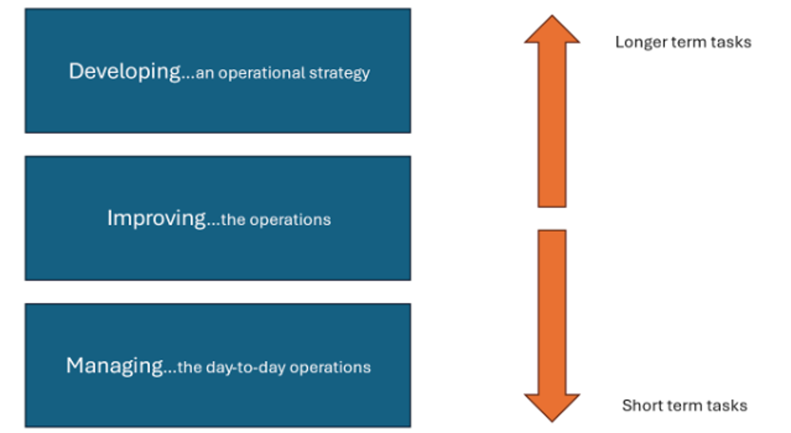
The three operational tasks
Service operational tasks may involve long term, medium term and short-term objectives
These three tasks require a wide range of skills, adding to the complexity of the role
Good operations management is about ensuring all three tasks have appropriate allocation of time assigned to them
The Hospitality Manager Operational Tasks. Source: Adapted from Johnson
and Clarke (2020, p4)

Slide 14
Defining service strategy
A company’s service strategy is shown in the pattern of decisions that the organisation takes to develop its service resources and processes.
A service strategy should seek to achieve four principles:
  Mirror the strategic aims of the business
  Satisfy the requirements of the chosen market
  Design, implement and deliver an appropriate, effective and efficient service
  Develop and exploit the capabilities of the organisation’s resources and processes
For the service operation to be successful and meet the overall business strategy, it must achieve all of the four principles

Slide 15
Service strategy and reflecting the strategic aims of the business
Most organisations take what is termed the ‘top-down’ view of strategy
  Corporate level, what types of business the group needs to be in, geographical location, acquisitions, investments, and allocation of funds
  Group level, e.g. the strategy of one brand (a chain of restaurants for example), executive team will set out missions and objectives, defining how it intends to compete in its chosen market
  Unit level (e.g. restaurant) , the operations manager will consider and demonstrate how the brands mission and objectives will contribute to the success of the unit

Slide 16
Service strategy satisfying the requirements of the market and the ‘outside-in’ view of strategy
Customers: are influenced by the organisation’s key competitors
Marketing function: identifies and anticipates customer requirements
Service operations function: to design and implement appropriate service processes to match these customer requirements
The ‘outside-in’ view of strategy: ensuring that service strategy takes market requirements into account

Slide 17
The ‘top-down’ designed service strategy
The role of service operations management is to implement the ‘top-down’ designed service strategy.
Effective service strategies are evolutionary rather than revolutionary.
During day-to-day experiences, the operations team will measure, monitor and analyse service performance data. E.g. spend per head.
  Thus, informed decisions can be made on improvements to the service strategy
  Crucially, these staff have the task of ‘living the strategy’ first hand
  Staff who are committed to the goals and objectives will seem obvious to the customer
  Total involvement is the key to success.

Slide 18
Why is service strategy important?
Service operations are just too important to be allowed to ‘potter along’ or where staff continue to do things in their own way.
Service strategy needs to:
  Prevent disjointed activities and poor decision making
  Provide employees a coherent service strategy with a strategic direction.
  Prevent the possibility of fragmented decision making
An effective service strategy has the potential for:
  A company’s investment to be fully realised
  The foundation of business success

Slide 19
Creation, communication and implementation of the service strategy
The service strategy is created, developed and written down by senior management
A visionary thinker, at chief executive level, who is responsible for developing a service strategy which gives the organisation its reason for being
  This will act as a ‘blueprint’ of referral for the interpretation of this strategy into policies and plans by senior and middle management.
  Management at unit/operational level have a clear implementation strategy with an outline of initiatives and activities

Slide 20
The six critical elements of strategy
The six critical elements of strategy all need to be aligned in the delivery of service to achieve the strategic objectives:
  A detailed understanding of the market environment
  An understanding of the internal environment
  A statement of market positioning of the service(s)
  The development of an effective service concept
  Clearly identified operations performance objectives
  The development of appropriate service resources and processes
The process requires a continuous approach to monitoring performance in all elements to ensure that objectives are being met

Slide 21
Sustainable service strategy and competitive advantage
Improving and maintaining high and consistent standards of service can help an organisation make gains in market share
Effective great service delivery can:
  Be a competitive weapon
  Differentiate the organisation
  Enhance customer expectations
  Prompt repeat custom and reputation
  Reduce operating costs through efficiencies gained

Slide 22
Seeking world class service delivery
Some service organisations have a vision to be the best in class.
World class customer service:
  Is the gold standard of customer care.
  Means having the capacity to provide a memorable, unforgettable experience to each individual customer.
  Aims to exceed customer expectations, creating memorable experiences and building lasting relationships.

Slide 23
Seeking world class service delivery (cont’d)
Achieving world class customer service requires a combination of:
  Understanding customer needs
  Investing in training
  Using advanced technology
  Actively seeking feedback
  Continuously striving for improvement

Slide 24
How can service strategy be sustained?
Once implemented the operations service strategy affects directly and indirectly all stakeholders involved in the management team, employees, customers and suppliers
It must be a workable, meaningful, robust and sustainable
‘Sustainable’ does not mean unchanging
The monitoring and analysis of performance continues to take place throughout the service strategy cycle
Requires continuous appraisal of the external and internal environmental factors and with subsequent adjustments to strategy
Without this flexibility in service strategy organisations can lose market share. This can be termed as ‘institutional rusting

Slide 25
Avoiding ‘institutional rusting’
There are many symptoms that indicate the processes are not working well. Within the food service operation, they may include:
  Conflicting service objectives, e.g. menu items being added which impedes the speed of production and /or service
  Inappropriate and inflexible operations processes and resources e.g. inappropriate equipment
  Inappropriate investment in staff training and development
  Undetected changes to the service concept e.g. unit manager misinterpreting the concept
Service strategy involves the process of continually checking the organisation’s plans for direction, progress and cohesion with the continually evolving environment

Slide 26
Visionary leadership – making it happen
A major influence over the successful implementation of service strategy and its sustainability is visionary leadership. This entails:
  a business style that focuses on a long-term plan
  an individual who understands the current organisation, who can articulate a clear vision, inspiring and enthusing others
  an individual who will galvanise the organisation to bring about the realisation of his/her service vision
Qualities of visionary leaders include:
  Resilience
  Charisma
  Creativity
  Emotional intelligence
  Excellent communication

Slide 27
Summary
Food service operations have additional unique attributes
To be truly successful businesses must adopt good service design
The role of the service operations manager plays a critical role in ensuring the service design strategy is implemented and the organisation’s business objectives and subsequent mission is achieved
A well-designed service strategy, and effective service design, is fundamental in managing a successful food and beverage business
The service strategy should be ‘Sustainable’ and maintained throughout the service strategy cycle
Service strategy involves the process of continually checking the organisation’s plans for direction, progress, and cohesion with the continually evolving environment

Slide 28
Revision Questions
What are the three core functions of any organisation?
What differentiates service operations from other operational management? e.g. manufacturing.
The service operations manager plays a critical role in organisational success. What areas of the business does the unit manager get involved in and need to have an in-depth knowledge and understanding of?

Slide 29
Revision Questions (cont’d)
Service operations are just too important to be allowed to ‘potter along’ or where staff continue to do things in their own way. Why is service strategy so important?
How can service strategy be sustained?
What is visionary leadership? Research and discover a well-known visionary leader from your own country? What are his/her characteristics?

Slide 30
End of Chapter 9 presentation

Slide 31
Culinary and Food Service Operations Management for Industry 5.0
David Graham is an Associate Head at Sheffield Hallam University within Sheffield Business School, a visiting Research Fellow at the University of Zululand, South Africa and Principal Fellow of Higher Education Academy.
Ewen Crilley is a Senior Lecturer at Sheffield Hallam University and Course Leader for UG and PG Tourism, Hospitality, Culinary and Aviation.
Peter Cox worked in the hotel and contract catering for large international companies. He was a Senior Lecturer at Leeds Beckett University specialising in quality and hospitality operations management.
John Cousins is a consultant, educator, and the author of a range of food and beverage management and service publications, He has been conferred at Culinary Arts Laureate and is Director of the Food and Beverage Training Company.
© 2026 David Graham et al. Culinary and Food Service Operations Management for Industry 5.0. Goodfellow Publishers

